Slide 1
Spring IOC Container Advanced Concepts

Slide 2
Invoking another method
<bean id="force-init" class="org.springframework.beans.factory.config.MethodInvokingFactoryBean">
  <property name="staticMethod"><value>com.example.MyClass.initialize</value></property>
</bean>
<bean id="bean1" class="..." depends-on="force-init">
...
</bean>

Slide 3
Setting a bean property from a property expression
<bean id="person" class="org.springframework.beans.TestBean" singleton="false">
  <property name="age"><value>10</value></property>
  <property name="spouse">
    <bean class="org.springframework.beans.TestBean">
      <property name="age"><value>11</value></property>
    </bean>
  </property>
</bean>
<bean id="theAge" class="org.springframework.beans.factory.config.PropertyPathFactoryBean">
  <property name="targetBeanName"><value>person</value></property>
  <property name="propertyPath"><value>spouse.age</value></property>
</bean>

Slide 4
Method replacement
Original Class
  public class MyValueCalculator {
    ... some real code
    public String computeValue(String input) {
  }
MethodReplacer
  public class ReplacementComputeValue implements MethodReplacer {
    public Object reimplement(Object o, Method m, Object[] args) throws Throwable {
    // get the input value, work with it, and return a computed result
    String input = (String) args[0];
    ...
    return ...;
  }

Slide 5
Cont …
<bean id="myValueCalculator class="x.y.z.MyValueCalculator">
  <!-- arbitrary method replacement -->
  <replaced-method name="computeValue" replacer="replacementComputeValue">
    <arg-type>String</arg-type>
  </replaced-method>
</bean>
<bean id="replacementComputeValue" class="a.b.c.ReplaceMentComputeValue"/>

Slide 6
Custom property Editors

Slide 7
AutoWiring
byName
  Attempts to find a bean in the container whose name (or ID) is the same as the name of the property being wired .
byType
  Attempts to find a single bean in the container whose type matches the type of the property being wired.
Constructors
  Tries to match up one or more beans in the container with the parameters of one of the constructors of the bean being wired.
Autodetect
  By constructor first and then byType.

Slide 8
Aspect Oriented Programming

Slide 9
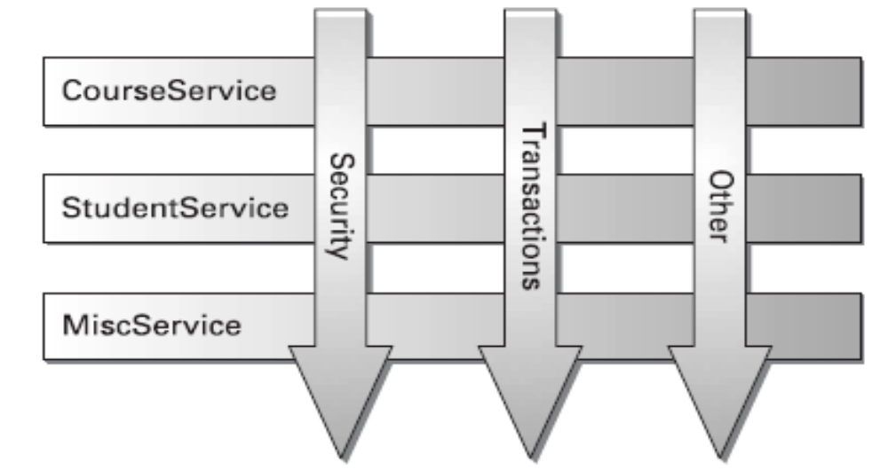
Spring AOP (Aspect Oriented Programming)
Spring’s AOP framework allows as to code functionality that is sprinkled throughout our application in one place—an aspect.
modularization of crosscutting concerns.

Slide 10
Cont …
With AOP, we still define the common functionality in one place.
We can declaratively define how and where this functionality is applied without having to modify the class to which we are applying the new feature.
Cross-cutting concerns can now be modularized into special objects called aspects.

Slide 11
AOP terminology
Aspect
  An aspect is the cross-cutting functionality which we are implementing.
  The most common example of an aspect is logging.
Joinpoint
  A joinpoint is a point in the execution of the application where an aspect can be plugged in.
  This point could be a method being called, an exception being thrown, or even a field being modified.
Advice
  Advice is the actual implementation of our aspect.
  It is advising our application of new behavior.
  Advice is inserted into our application at joinpoints.

Slide 12
Cont ..
Pointcut
  A pointcut defines at what joinpoints advice should be applied.
  Advice can be applied at any joinpoint supported by the AOP framework.
  Pointcuts allow us to specify where we want our advice to be applied.
Introduction
  An introduction allows you to add new methods or attributes to existing classes.
Target
  A target is the class that is being advised.

Slide 13
Cont …
Proxy
  A proxy is the object created after applying advice to the target object.
Weaving
  Weaving is the process of applying aspects to a target object to create a new, proxied object.
  Compile time
    Aspects are woven in when the target class is compiled. This requires a special compiler.
  Classload time
    Aspects are woven in when the target class is loaded into the JVM.
    This requires a special ClassLoader that enhances that target class’s bytecode before the class is introduced into the application.
  Runtime
    Aspects are woven in sometime during the execution of the application.

Slide 14
Spring’s AOP implementation
Spring advice is written in Java.
Spring’s advises objects at runtime.
  If our target object implements an interface(s) that exposes the required methods, Spring will use the JDK’s java.lang.reflect.Proxy class.
  If our target class does not implement an interface, Spring uses the CGLIB library to generate a subclass to your target class.
Spring implements AOP Alliance interfaces.
Spring only supports method joinpoints.

Slide 15
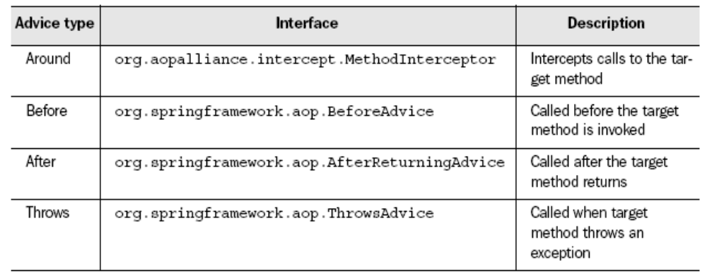
Advice types in Spring

Slide 16
Example for the Advice

